Slide 1
Tutorial 6 Mid-Semester exam practice

Slide 2
Details of the Mid-semester exam
Format: Online
Date: Wednesday 21 October 2020
Time: 6:00pm, Sydney time
Duration: 50 minutes including reading time
You are also given additional time for accessing the exam and uploading your answers. As a result, the upload is due at 7:05pm, with a last possible time of upload of 7:20pm. (There is no penalty for an upload between 7:05pm and 7:20pm.)

Slide 3
Format of the exam
Open book.
Three questions.
All questions are short answer, requiring written or mathematical responses.
You are required to upload your answers to all three questions.

Slide 4
How do I scan my answers?
Here are 4 options:
Evernote Scannable (only available on iPhone/iPad) : https://evernote.com/products/scannable/
Adobe Scan: https://acrobat.adobe.com/au/en/mobile/scanner-app.html
Microsoft Office Lens: https://play.google.com/store/apps/details?id=com.microsoft.office.officelens&hl=en_US and https://apps.apple.com/au/app/microsoft-office-lens-pdf-scan/id975925059
CamScanner: https://www.camscanner.com/ (recommended)

Slide 5
How do I scan my answers?
Acceptable formats for upload: pdf, doc, docx.
I have provided a practice space for you to practice the upload process before the mid-semester exam.
I will close that upload space at end of day on Tuesday 20 October to ensure there is no confusion about where to upload the following day.
It is important that you take the opportunity to check which app works best for you before the final exam and to practice the uploading process.

Slide 6
What material is assessable?
All material from weeks 1 to 6:
The Economic Approach
Game Theory
Market Structure
Pricing
Product differentiation
What is a firm?
Material covered in both the lectures and tutorials is assessable. Week 7 material on organizational structure and decision making is not assessable in the mid-semester.

Slide 7
2016 Mid-semester Exam Q1(i)
Describe what is meant by first degree price discrimination. Describe what is meant by third degree price discrimination. What challenges might a firm face in implementing either first degree price discrimination or third degree price discrimination?

Slide 8
2016 Mid-semester Exam Q1(i)
Under first degree price discrimination individuals are charged their willingness to pay for each unit consumed.
The main challenge for such an approach is that it is unlikely that firms will be able to identify the individual’s willingness to pay as individuals will generally misreport this.
Under third degree price discrimination different groups of customers are charged different prices depending on their own price elasticity of demand. Hence, consumes with inelastic demand are generally charged a higher price.
There are two challenges associated with this pricing strategy – first you must be able to distinguish between different customer groups (based on gender, student or pensioner status – for example using a concession card). Second, you must be able to prevent arbitrage or resale – this is easy with a service, though it may also require that a condition of sale is that the item is not resold.

Slide 9
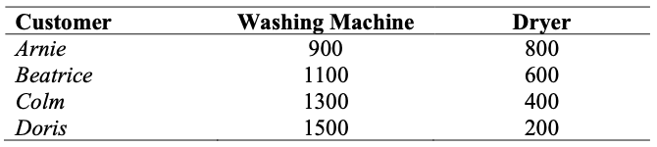
2016 Mid-semester Exam Q1(ii)
Consider a firm that sells two products, namely washing machines and tumble dryers. There are 4 customers each which as the valuation indicated in the table below:
The marginal and average cost of making a washing machine is $1000, and the marginal and average cost of making a dryer is $300.
Suppose the firm sells each item individually. Which set of prices will maximize profit? (a) Pw=900; PD=400 (b) Pw=1300; PD=600 (c) Pw=1500; PD=600

Slide 10
2016 Mid-semester Exam Q1(ii)
Prices | Sales of W | Sales of D | Revenue | Costs | Profit
P_{w} = 900 P_{d} =400
P_{w} = 1300 P_{d} = 600
P_{w} = 1500 P_{d} = 600

Slide 11
2016 Mid-semester Exam Q1(ii)
Prices | Sales of W | Sales of D | Revenue | Costs | Profit
P_{w} = 900 P_{d} =400 | 4 | 3 (All except Doris) | 4x900+3x400=4800 | 4x1000+3x300=4900 | -100
P_{w} = 1300 P_{d} = 600
P_{w} = 1500 P_{d} = 600

Slide 12
2016 Mid-semester Exam Q1(ii)
Prices | Sales of W | Sales of D | Revenue | Costs | Profit
P_{w} = 900 P_{d} =400 | 4 | 3 (All except Doris) | 4x900+3x400=4800 | 4x1000+3x300=4900 | -100
P_{w} = 1300 P_{d} = 600 | 2 (Colm and Doris) | 2 (Arnie and Beatrice) | 2x1300+2x600=3800 | 2x1000+2x300=2600 | 1200
P_{w} = 1500 P_{d} = 600

Slide 13
2016 Mid-semester Exam Q1(ii)
Prices | Sales of W | Sales of D | Revenue | Costs | Profit
P_{w} = 900 P_{d} =400 | 4 | 3 (All except Doris) | 4x900+3x400=4800 | 4x1000+3x300=4900 | -100
P_{w} = 1300 P_{d} = 600 | 2 (Colm and Doris) | 2 (Arnie and Beatrice) | 2x1300+2x600=3800 | 2x1000+2x300=2600 | 1200
P_{w} = 1500 P_{d} = 600 | 1 (Doris) | 2 (Arnie and Beatrice) | 1x1500+2x600=2700 | 1x1000+2x300=1600 | 1100

Slide 14
2016 Mid-semester Exam Q1(ii)
Consider a firm that sells two products, namely washing machines and tumble dryers. There are 4 customers each which as the valuation indicated in the table below:
The marginal and average cost of making a washing machine is $1000, and the marginal and average cost of making a dryer is $300.
What is the profit maximizing price if a pure bundle is offered? The price of the bundle is given by P_{B}. (a) PB=1500 (b) PB=1600 (c) PB=1700

Slide 15
2016 Mid-semester Exam Q1(ii)
Prices | Sales of Bundle | Revenue | Costs | Profit
P_{B} = 1500
P_{B} = 1600
P_{B} = 1700

Slide 16
2016 Mid-semester Exam Q1(ii)
Prices | Sales of Bundle | Revenue | Costs | Profit
P_{B} = 1500 | 4 | 6000 | 5200 | 800
P_{B} = 1600
P_{B} = 1700

Slide 17
2016 Mid-semester Exam Q1(ii)
Prices | Sales of Bundle | Revenue | Costs | Profit
P_{B} = 1500 | 4 | 6000 | 5200 | 800
P_{B} = 1600 | 4 | 6400 | 5200 | 1200
P_{B} = 1700

Slide 18
2016 Mid-semester Exam Q1(ii)
Prices | Sales of Bundle | Revenue | Costs | Profit
P_{B} = 1500 | 4 | 6000 | 5200 | 800
P_{B} = 1600 | 4 | 6400 | 5200 | 1200
P_{B} = 1700 | 4 | 6800 | 5200 | 1600

Slide 19
2016 Mid-semester Exam Q1(ii)
Consider a firm that sells two products, namely washing machines and tumble dryers. There are 4 customers each which as the valuation indicated in the table below:
The marginal and average cost of making a washing machine is $1000, and the marginal and average cost of making a dryer is $300.
What is the profit maximizing price if a mixed bundling strategy is used?
(a) P_{W} = 1299; P_{D} = 699; P_{B} = 1000 (b) P_{W} = 1499; P_{D} = 799; P_{B} = 1700 (c) P_{W} = 1699; P_{D} = 799; P_{B} = 1700

Slide 20
2016 Mid-semester Exam Q1(ii)
Prices | Sales of W | Sales of D | Sales of B | Revenue | Costs | Profit
P_{w} = 1299 P_{d} = 699 P_{B} = 1000
P_{w} = 1499 P_{d} = 799 P_{B} = 1700
P_{w} = 1699 P_{d} = 799 P_{B} = 1700

Slide 21
2016 Mid-semester Exam Q1(ii)
Prices | Sales of W | Sales of D | Sales of B | Revenue | Costs | Profit
P_{w} = 1299 P_{d} = 699 P_{B} = 1000 |  |  | 4 | 4000 | 5200 | -1200
P_{w} = 1499 P_{d} = 799 P_{B} = 1700
P_{w} = 1699 P_{d} = 799 P_{B} = 1700

Slide 22
2016 Mid-semester Exam Q1(ii)
Prices | Sales of W | Sales of D | Sales of B | Revenue | Costs | Profit
P_{w} = 1299 P_{d} = 699 P_{B} = 1000 |  |  | 4 | 4000 | 5200 | -1200
P_{w} = 1499 P_{d} = 799 P_{B} = 1700 | 1 (Doris) | 1 (Arnie) | 2 (Beatrice and Colm) | 1499 + 799 + 2x1700 = 5698 | 3x1000 + 3x300 = 3900 | 1798
P_{w} = 1699 P_{d} = 799 P_{B} = 1700

Slide 23
2016 Mid-semester Exam Q1(ii)
Prices | Sales of W | Sales of D | Sales of B | Revenue | Costs | Profit
P_{w} = 1299 P_{d} = 699 P_{B} = 1000 |  |  | 4 | 4000 | 5200 | -1200
P_{w} = 1499 P_{d} = 799 P_{B} = 1700 | 1 (Doris) | 1 (Arnie) | 2 (Beatrice and Colm) | 1499 + 799 + 2x1700 = 5698 | 3x1000 + 3x300 = 3900 | 1798
P_{w} = 1699 P_{d} = 799 P_{B} = 1700 |  | 1 (Arnie) | 3 | 799 + 3x1700 = 5899 | 3x1000 + 4x300 = 4200 | 1699

Slide 24
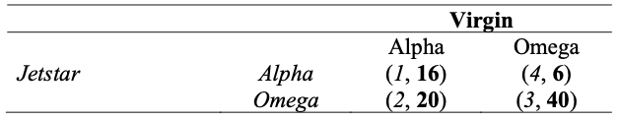
2016 Mid-semester Exam Q3
Consider the following game played between Jetstar and Virgin. Each can make a decision about installing some navigation software on their planes. The two types of software are called Alpha and Omega. The payoffs from the choices made (in $ millions) are presented in the following payoff matrix. Note that Jetstar’s payoff is shown first:
Is there a pure strategy Nash Equilibrium in this game?

Slide 25
2016 Mid-semester Exam Q3
Consider the following game played between Jetstar and Virgin. Each can make a decision about installing some navigation software on their planes. The two types of software are called Alpha and Omega. The payoffs from the choices made (in $ millions) are presented in the following payoff matrix. Note that Jetstar’s payoff is shown first:
Is there a pure strategy Nash Equilibrium in this game?

Slide 26
2016 Mid-semester Exam Q3
Consider the following game played between Jetstar and Virgin. Each can make a decision about installing some navigation software on their planes. The two types of software are called Alpha and Omega. The payoffs from the choices made (in $ millions) are presented in the following payoff matrix. Note that Jetstar’s payoff is shown first:
Is there a pure strategy Nash Equilibrium in this game?

Slide 27
2016 Mid-semester Exam Q3
Consider the following game played between Jetstar and Virgin. Each can make a decision about installing some navigation software on their planes. The two types of software are called Alpha and Omega. The payoffs from the choices made (in $ millions) are presented in the following payoff matrix. Note that Jetstar’s payoff is shown first:
Is there a pure strategy Nash Equilibrium in this game?

Slide 28
2016 Mid-semester Exam Q3
Consider the following game played between Jetstar and Virgin. Each can make a decision about installing some navigation software on their planes. The two types of software are called Alpha and Omega. The payoffs from the choices made (in $ millions) are presented in the following payoff matrix. Note that Jetstar’s payoff is shown first:
Is there a pure strategy Nash Equilibrium in this game?

Slide 29
2016 Mid-semester Exam Q3
Consider the following game played between Jetstar and Virgin. Each can make a decision about installing some navigation software on their planes. The two types of software are called Alpha and Omega. The payoffs from the choices made (in $ millions) are presented in the following payoff matrix. Note that Jetstar’s payoff is shown first:
What is the mixed strategy Nash Equilibrium in this game?

Slide 30
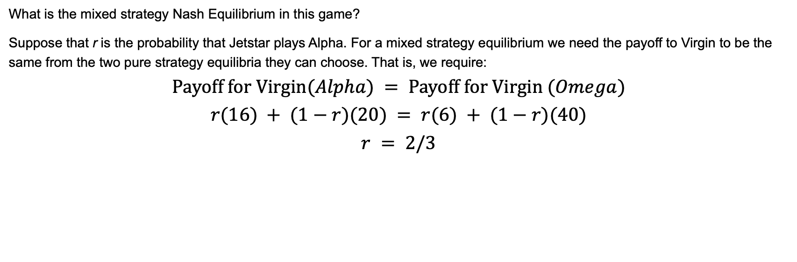
2016 Mid-semester Exam Q3
What is the mixed strategy Nash Equilibrium in this game?
Suppose that r is the probability that Jetstar plays Alpha. For a mixed strategy equilibrium we need the payoff to Virgin to be the same from the two pure strategy equilibria they can choose. That is, we require:
$$\text{Payoff} \text{for} \text{Virgin}(Alpha) = \text{Payoff} \text{for} \text{Virgin} (Omega)$$
$$r(16) + (1−r)(20) = r(6) + (1−r)(40)$$
$$r = 2/3$$

Slide 31
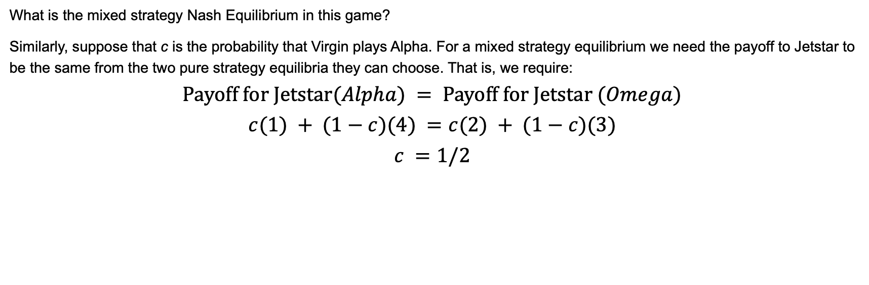
2016 Mid-semester Exam Q3
What is the mixed strategy Nash Equilibrium in this game?
Similarly, suppose that c is the probability that Virgin plays Alpha. For a mixed strategy equilibrium we need the payoff to Jetstar to be the same from the two pure strategy equilibria they can choose. That is, we require:
$$\text{Payoff} \text{for} \text{Jetstar}(Alpha) = \text{Payoff} \text{for} \text{Jetstar} (Omega)$$
$$c(1) + (1−c)(4) =c(2) + (1−c)(3)$$
$$c =1/2$$

Slide 32
2016 Mid-semester Exam Q3
Jointly, Virgin and Jetstar get higher payoffs when Jetstar chooses Omega. Why does Virgin not always choose Omega. How might such an outcome, Virgin choosing Omega, be achieved?
Both airlines are assumed to act in their own self interest – that is they look at their own payoff rather than how total payoffs can be maximised. With this, even though payoffs are maximised (in total) when both play Omega, when Jetstar plays Alpha it is in the interest of Virgin to play Alpha.

Slide 33
2017 Mid-semester Exam Q2
The Ramrods are a small music band that sells music over the internet to two different types of consumers. The demand curve for each type of consumer is set out below.
Type A consumer: p = 30 – Q
Type B consumer: p = 20 – Q
Assume that the band has come up with a new pricing strategy which means that they offer buyers one of two options/ packages.
Basic: 20 songs at a total price of 200.
Premium: 30 songs at a total price of 450.
With these options/ packages, what will each type of purchaser buy? Note you should assume that each buyer buys one package and they choose the one that maximizes surplus.

Slide 34
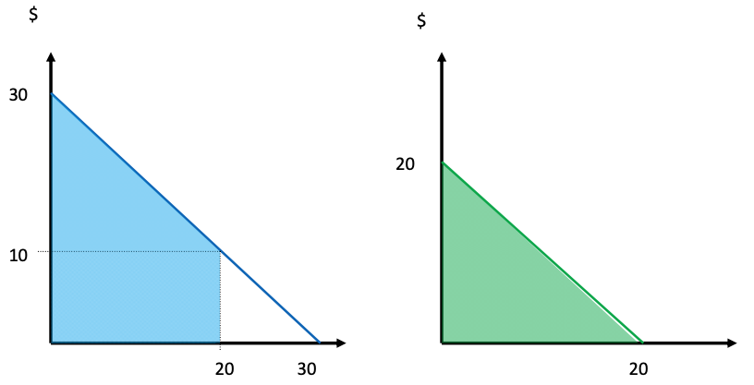
2017 Mid-semester Exam Q2
Type A consumer
Type B consumer

Slide 35
2017 Mid-semester Exam Q2
Type A consumer
For person A willingness to pay:
wtp₂₀ = (10)(20) + 0.5(20)(20) = 400 (This is the blue shaded area in the diagram)
wtp₃₀ = 0.5(30)(30) = 450 (This is the full triangle)
Person A gets consumer surplus of 200 from the basic package and zero consumer surplus from the premium package. They buy the basic package.

Slide 36
2017 Mid-semester Exam Q2
For person B willingness to pay:
wtp₂₀ = 0.5(20)(20) = 200
Person B will buy the basic package.
Type B consumer

Slide 37
2017 Mid-semester Exam Q2
Type A consumer
If they continue to sell the Basic package, what is the maximum price they can charge for the premium package to maximize profit?
To get the type A buyer to purchase the premium package it must offer at least as much consumer surplus as the basic package (200). Given type A buyers have a willingness to pay of 450 for the premium package (recall wtp₃₀ = 0.5(30)(30) = 450), if they are charged 250 for the premium package it will give them 200 surplus and they will purchase it.

Slide 38
2017 Mid-semester Exam Q3
Suppose that we have two restaurants located at either end of a road that is 100 kilometres long. Annie’s German restaurant is located at kilometre zero, and Masako’s Sushi Bar is located at kilometre 100. In each case the location of the firm is fixed and the only choice they have is over price. There are 100 consumers spaced equally along the road. Assume that the cost of travelling each kilometre is $1.
If meals at Annie’s cost $25, and meals at Masako’s cost $45, where will the marginal consumer be located?
Assume that the cost of preparing a meal costs $25 at both restaurants. Does this outcome represent a Nash equilibrium? Why or why not? Hint: Ask yourself if Annie has any incentive to change her behaviour given that Masako does not change their behaviour.

Slide 39

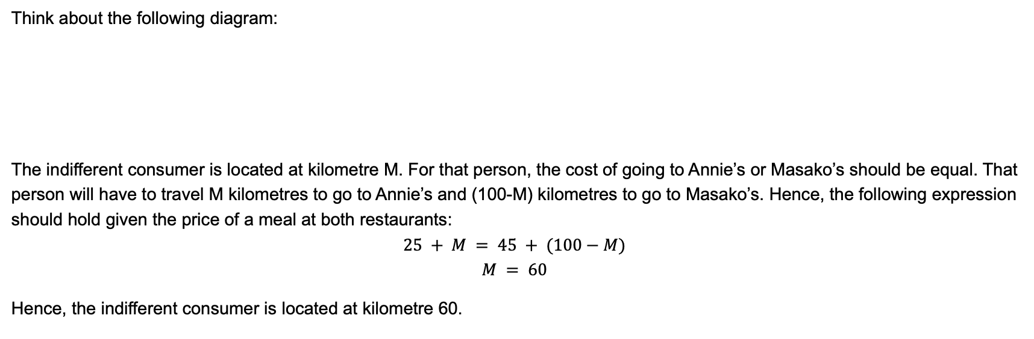
2017 Mid-semester Exam Q3
Think about the following diagram:
The indifferent consumer is located at kilometre M. For that person, the cost of going to Annie’s or Masako’s should be equal. That person will have to travel M kilometres to go to Annie’s and (100-M) kilometres to go to Masako’s. Hence, the following expression should hold given the price of a meal at both restaurants:
$$25 + M = 45 + (100−M)$$
$$M = 60$$
Hence, the indifferent consumer is located at kilometre 60.

Slide 40
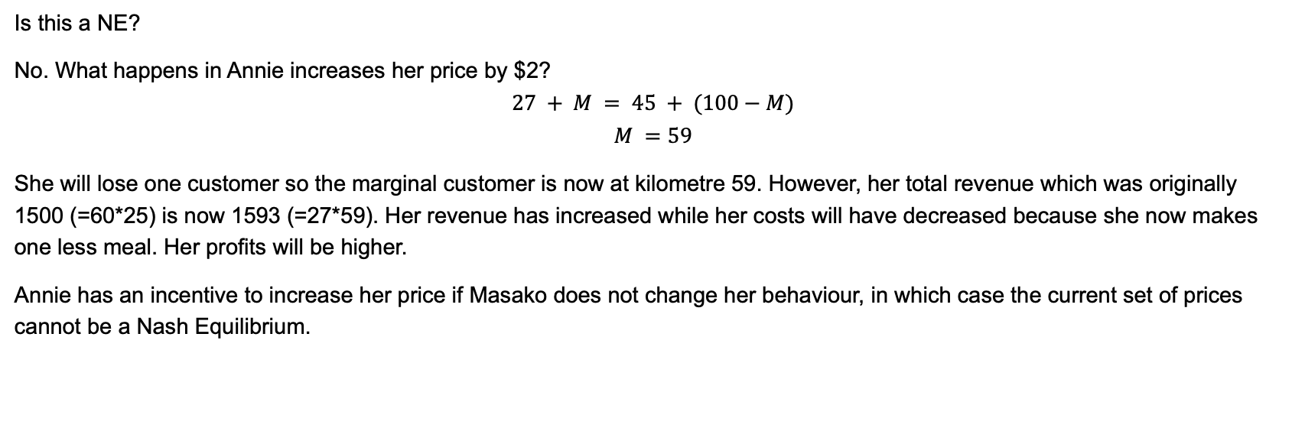
2017 Mid-semester Exam Q3
Is this a NE?
No. What happens in Annie increases her price by $2?
$$27 + M = 45 + (100−M)$$
$$M =59$$
She will lose one customer so the marginal customer is now at kilometre 59. However, her total revenue which was originally 1500 (=60*25) is now 1593 (=27*59). Her revenue has increased while her costs will have decreased because she now makes one less meal. Her profits will be higher.
Annie has an incentive to increase her price if Masako does not change her behaviour, in which case the current set of prices cannot be a Nash Equilibrium.

Slide 41
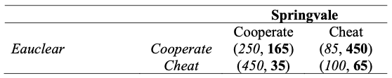
2017 Mid-semester Exam Q5
Consider two competitors (Springvale and Eauclear) that are considering working together to set a higher prices and thereby increase profits. After reaching an agreement the firms can choose to cooperate or cheat. The payoffs from cooperating and cheating are presented below:
Is there a pure strategy Nash Equilibrium in this game if the players make their choices simultaneously? If so identify it and describe what is meant by a Nash Equilibrium.

Slide 42
2017 Mid-semester Exam Q5
Consider two competitors (Springvale and Eauclear) that are considering working together to set a higher prices and thereby increase profits. After reaching an agreement the firms can choose to cooperate or cheat. The payoffs from cooperating and cheating are presented below:
Is there a pure strategy Nash Equilibrium in this game if the players make their choices simultaneously? If so identify it and describe what is meant by a Nash Equilibrium.

Slide 43
2017 Mid-semester Exam Q5
Consider two competitors (Springvale and Eauclear) that are considering working together to set a higher prices and thereby increase profits. After reaching an agreement the firms can choose to cooperate or cheat. The payoffs from cooperating and cheating are presented below:
Is there a pure strategy Nash Equilibrium in this game if the players make their choices simultaneously? If so identify it and describe what is meant by a Nash Equilibrium.

Slide 44
2017 Mid-semester Exam Q5
Consider two competitors (Springvale and Eauclear) that are considering working together to set a higher prices and thereby increase profits. After reaching an agreement the firms can choose to cooperate or cheat. The payoffs from cooperating and cheating are presented below:
Is there a pure strategy Nash Equilibrium in this game if the players make their choices simultaneously? If so identify it and describe what is meant by a Nash Equilibrium.

Slide 45
2017 Mid-semester Exam Q5
Consider two competitors (Springvale and Eauclear) that are considering working together to set a higher prices and thereby increase profits. After reaching an agreement the firms can choose to cooperate or cheat. The payoffs from cooperating and cheating are presented below:
Is there a pure strategy Nash Equilibrium in this game if the players make their choices simultaneously? If so identify it and describe what is meant by a Nash Equilibrium.

Slide 46
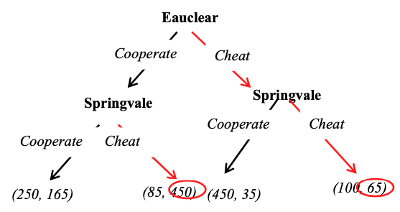
2017 Mid-semester Exam Q5
Draw a game tree for this game if Eauclear makes a decision and then Springvale makes its decision. Find the equilibrium outcome of the game:

